Slide 1
EMBT-ESE 4009
Testing of Components.
Project topic:Health monitoring device using IOT -connected headphone.
Group Number : 2
Group Members:
Christy Rachel Philip
Fahad Rahman
James M. Chacko
Premil Prasannan
Instructor : Mike Aleshams
Presented by,
Christy Rachel Philip

Slide 2
Contents
Introduction.
An Overview of the Project.
Engineering Drawing
Block Diagram
List of Testing Components.
Each Components and its Testing Process Explanation.
Conclusion.
References.

Slide 3
Introduction
This presentation includes the details regarding one of the basic task of our project, which is the Testing of Components. In this we are testing our major components such as ESP 32 microcontroller board which has an built GSM and Wi-fi module, Thermistor (Temperature sensor), MAX30102 Pulse Oximeter & Heart-Rate Module, Analog Heart Rate Monitor Sensor, One Wire Digital Temperature Sensor - DS18B20, GPS Module and a Push Button.

Slide 4
An Overview of the Project.
The topic of our project is “Health monitoring device using IOT-connected headphone.”
Our Project is an IoT-connected health care device, which is connected as a part of Bluetooth headphones. It consists of surface electrodes, temperature sensors, GPS, etc., to obtain various health-related data such as heartbeat rate, temperature, and EKG.
The device can be connected to a mobile phone through IoT. The user's information such as height, weight and previous history should be saved in the application. Using this, the family doctor can access it directly to monitor the patient's condition every day and communicate with them. Along with this, it has a push-button as well, so in case of emergencies, patient’s can press it by themselves and send information to 911 and doctor.

Slide 5
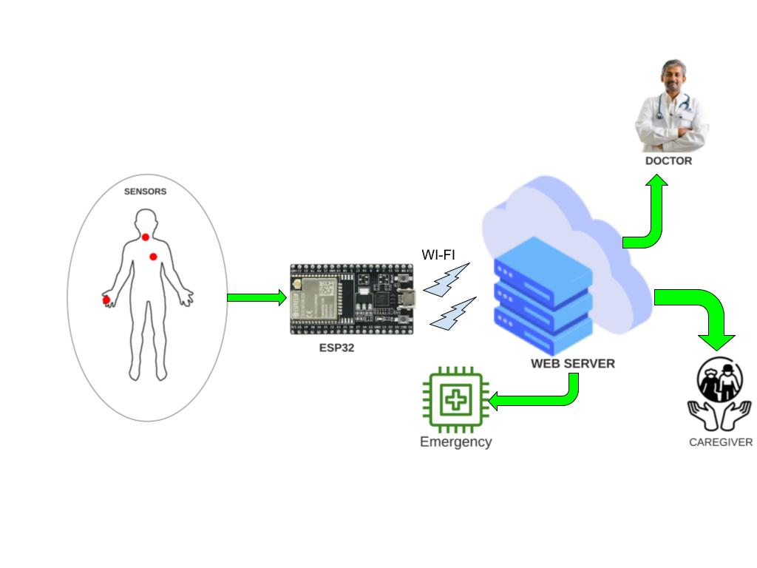
Engineering Drawing

Slide 6
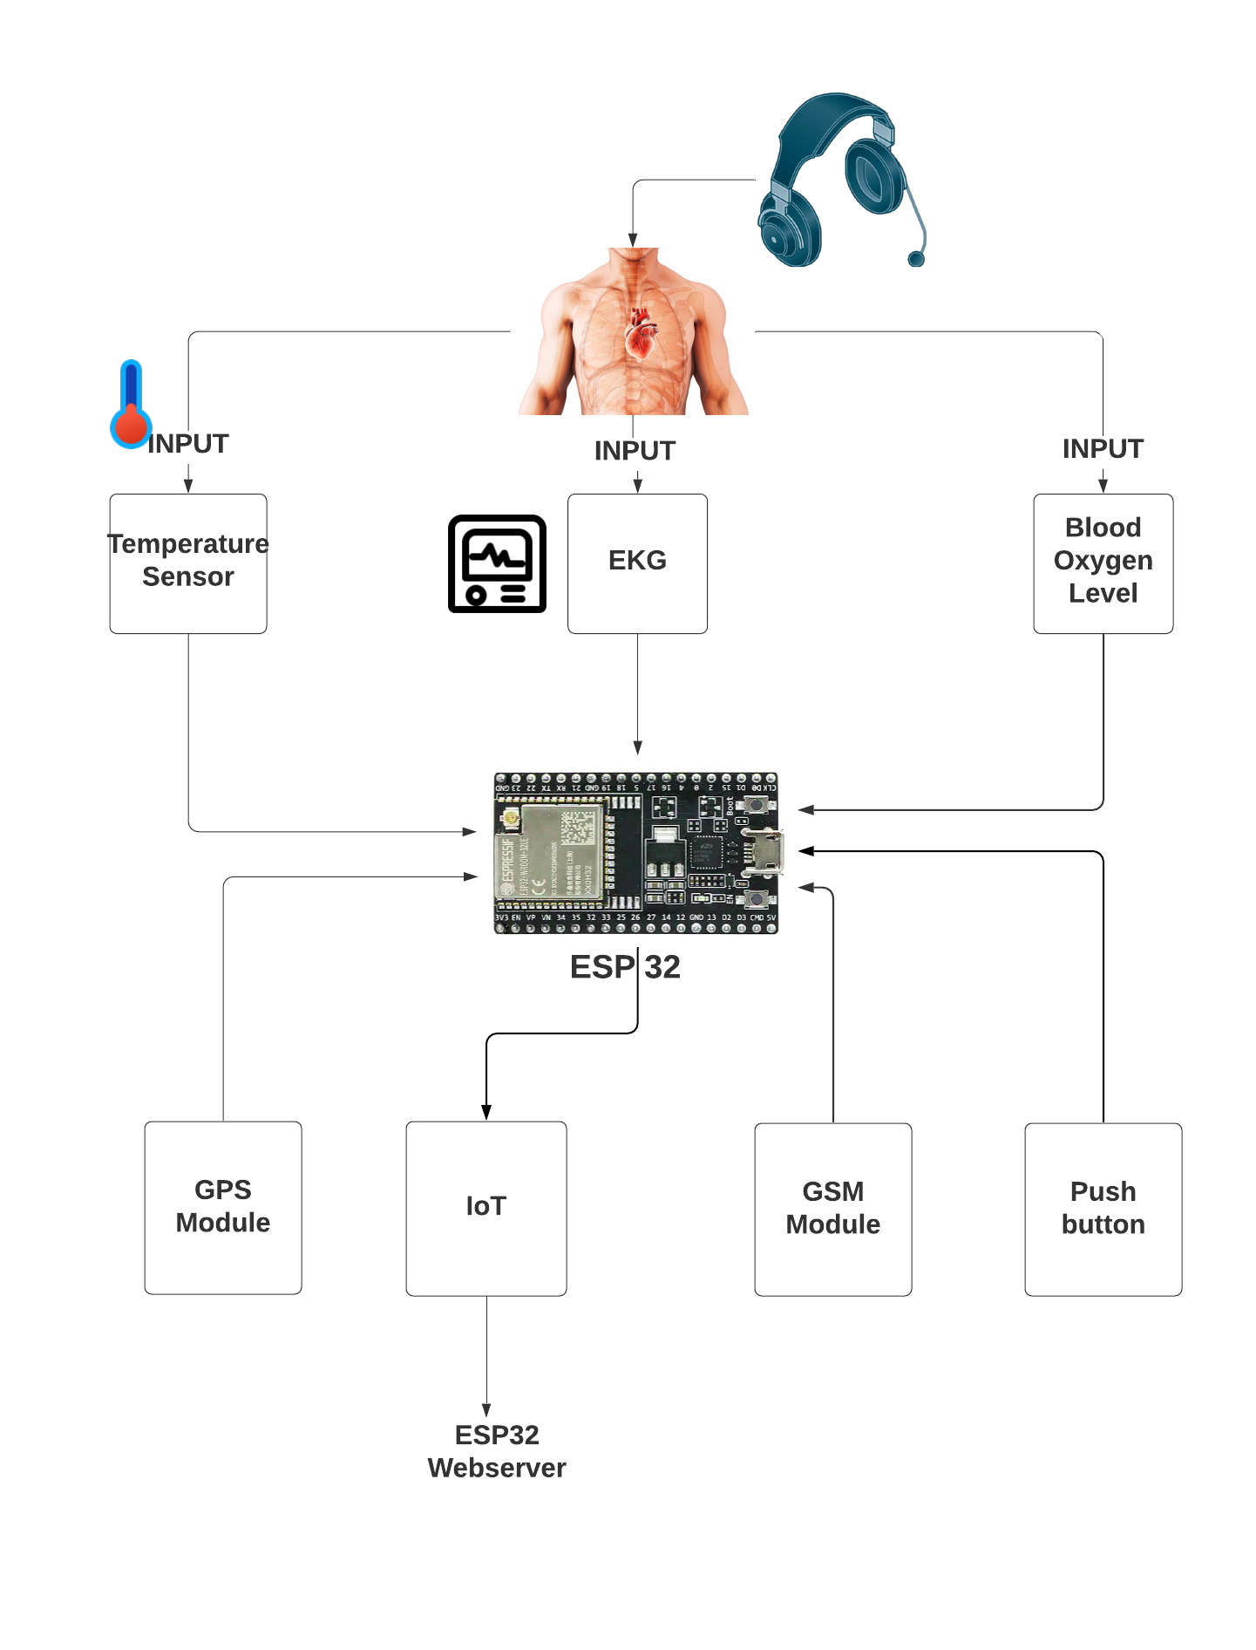
Block Diagram

Slide 7
3. Testing Components List
ESP32.
MAX30102 Pulse Oximeter & Heart-Rate Module.
One Wire Digital Temperature Sensor - DS18B20.
GPS Module.
GSM Module.
Push Button.
Lithium-ion Battery.

Slide 8
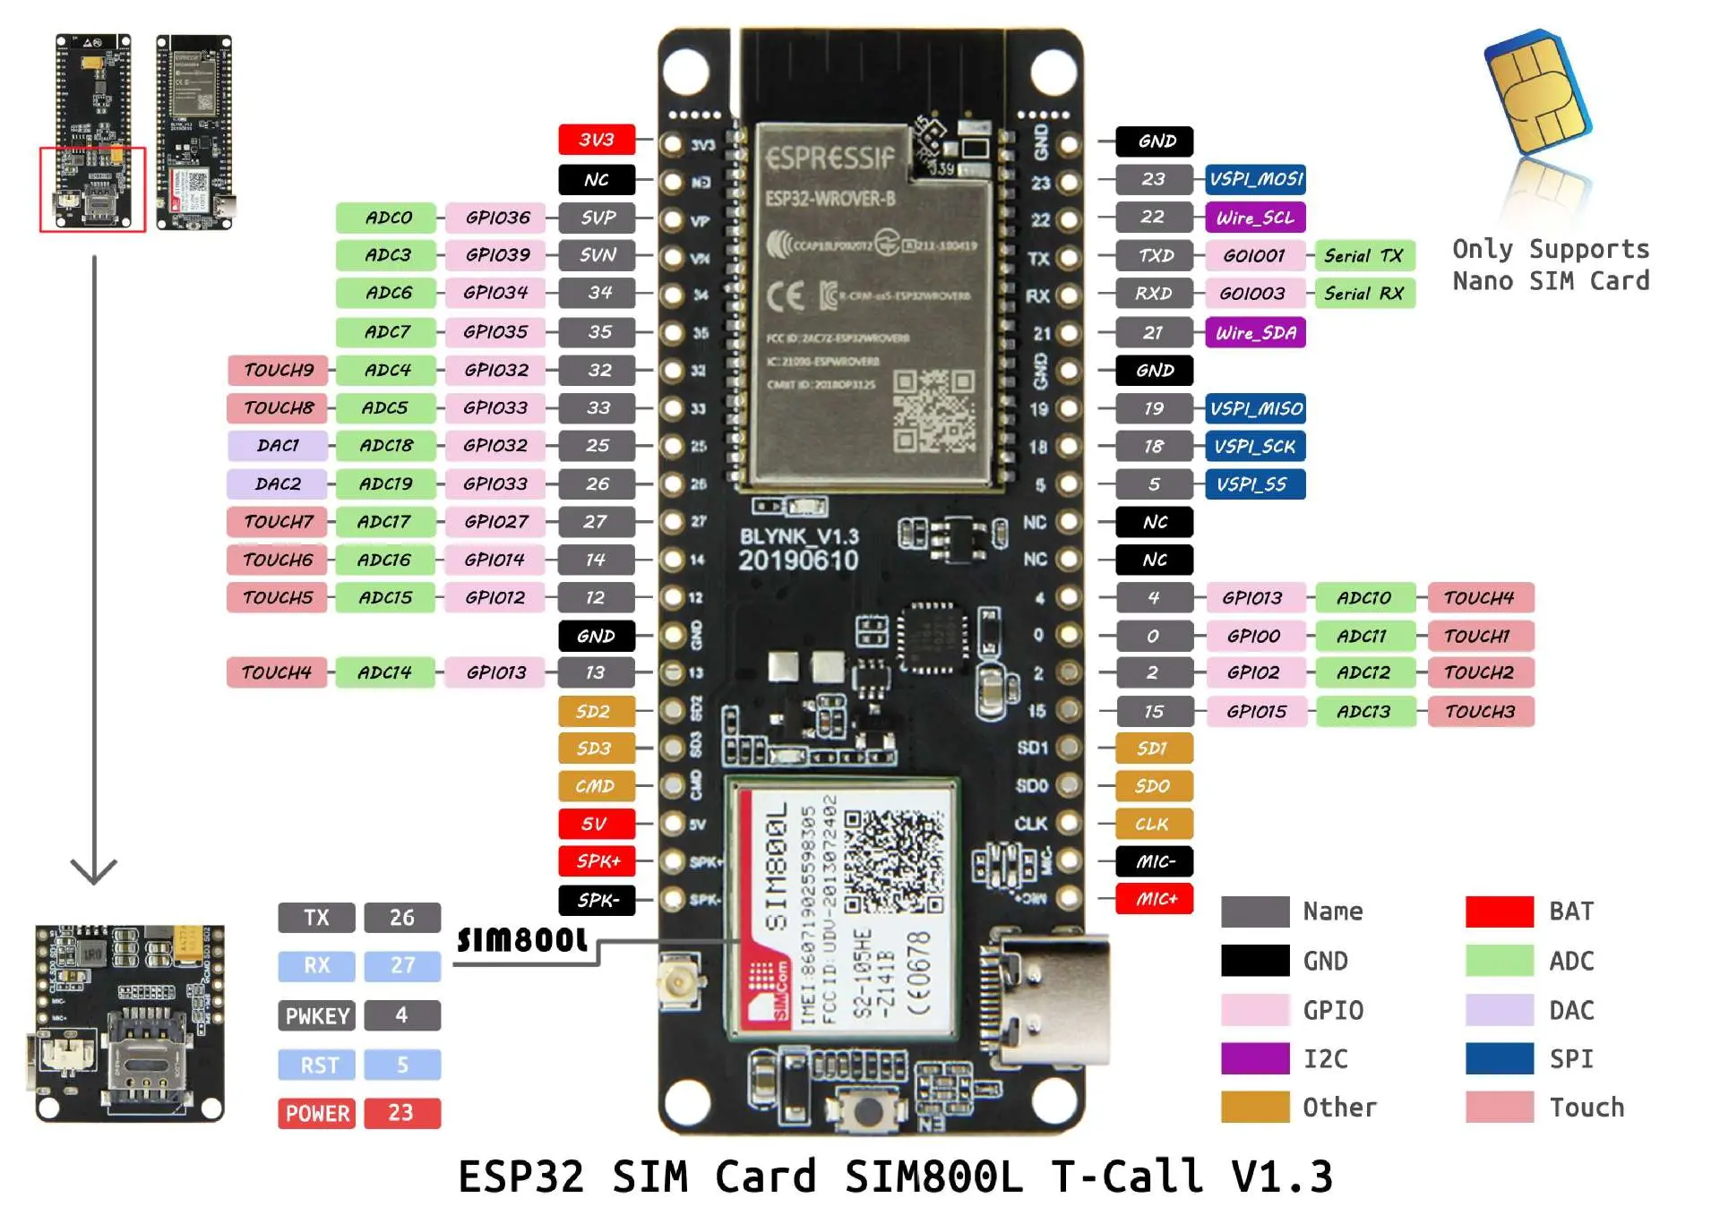
ESP32 Microcontroller Board

Slide 9
ESP32 Microcontroller Board
The ESP32 is an updated version of the ESP8266. It offers both Bluetooth, GSM and WiFi modules in-built in it. It is faster and is available in a dual-core design. It is also capable of operating in an ultra-low-power mode, ideal for battery-powered applications.
The ESP32 is powered from a micro-USB connector. Plug a USB cable with micro-B plug into the micro-USB socket on the board and the other end into a PC USB port to power up the board. A regulator on the board supplies the ESP-WROOM-32 module with 3.3V derived from the USB 5V.

Slide 10
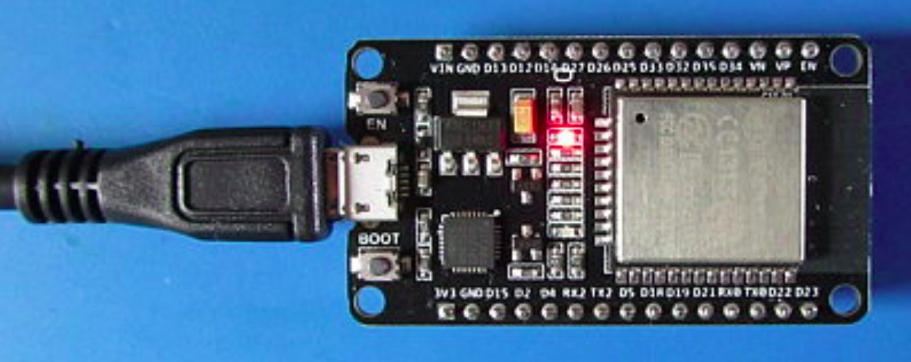
Testing Process
Power Indicator
The first and most basic test that can be done is to power up the board via a USB cable and to check that the red LED lights up as shown in the image below. This confirms that the 3.3V power from the on-board regulator is working.

Slide 11
Testing Process
Another method is to see if the board can be detected by the operating system and load drivers for it.
Linux Drivers
Linux drivers should already be installed on most Linux systems. Plug the ESP32 into the Linux PC using a USB cable and enter the following command to find the name of the port that the board is connected to.
dmesg | grep tty
A more basic and manual test to see if the drivers on a Linux computer have loaded is to first enter the following command in a terminal window without the board plugged into the PC.
ls /dev/tty*

Slide 12
Testing Process
Now plug the board in and run the same command again. The new device starting with tty that appears in the list is the ESP32. For example, it appears as ttyUSB0 on my Linux computer.
Also try the following command before and after plugging the board in to see if the board is configured as a ttyUSB device.
ls /dev/ttyUSB*

Slide 13
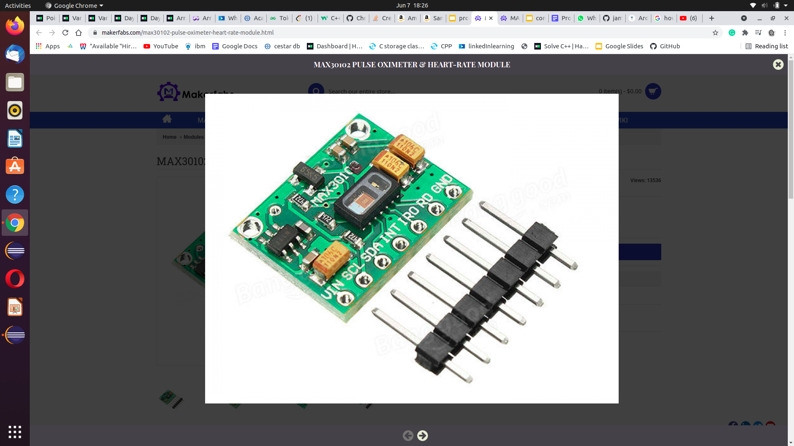
MAX30102 Pulse Oximeter & Heart-Rate Module.
￼￼The sensor is an integrated pulse oximetry and heart-rate monitor sensor solution. It combines two LED’s, a photo detector, optimized optics, and low-noise analog signal processing to detect pulse and heart-rate signals. It operates from 1.8V and 3.3V power supplies and can be powered down through software with negligible standby current, permitting the power supply to remain connected at all times.

Slide 14
Basic Working
The device has two LEDs, one emitting red light, another emitting infrared light. For pulse rate, only the infrared light is needed. Both the red light and infrared light is used to measure oxygen levels in the blood.
When the heart pumps blood, there is an increase in oxygenated blood as a result of having more blood. As the heart relaxes, the volume of oxygenated blood also decreases. By knowing the time between the increase and decrease of oxygenated blood, the pulse rate is determined.
It turns out, oxygenated blood absorbs more infrared light and passes more red light while deoxygenated blood absorbs red light and passes more infrared light. This is the main function of the MAX30100: it reads the absorption levels for both light sources and stored them in a buffer that can be read via I2C.

Slide 15
Testing Process
We are testing MAX30102 Pulse Oximeter & Heart-Rate Module with the help of an Arduino UNO.
Connections
Connect the Vin pin of MAX30102 to Vin pin of Arduino
Connect the GND pin of MAX30102 to GND pin of Arduino
Connect the SCL pin of MAX30102 to SCL pin of Arduino
Connect the SDA pin of MAX30102 to SDA pin of Arduino
When we do this connections and the Code is uploaded, we can place the finger on MAX30100 Sensor and open the serial monitor to see the values.
The circuit diagram and coding is adding in the following slides.

Slide 16
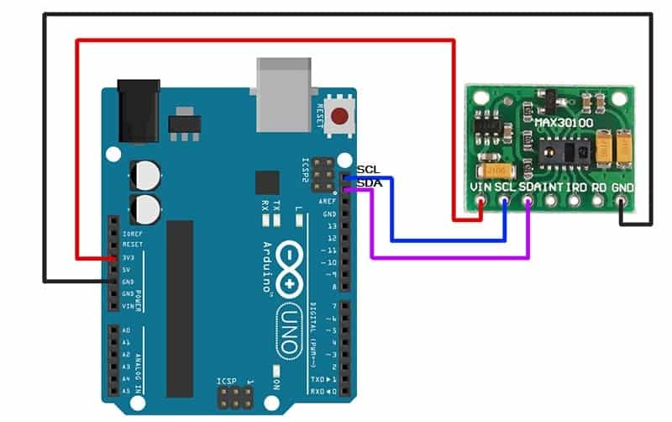
Circuit Diagram

Slide 17
Source Code
#include <Wire.h>
#include "MAX30100_PulseOximeter.h"
#define REPORTING_PERIOD_MS 1000
PulseOximeter pox;
uint32_t tsLastReport = 0;
void onBeatDetected(){
Serial.println("Beat!");
}
void setup(){
Serial.begin(115200);
Serial.print("Initializing pulse oximeter..");
// Initialize the PulseOximeter instance
// Failures are generally due to an improper I2C wiring, missing power supply
// or wrong target chip
if (!pox.begin()) {
Serial.println("FAILED");
for(;;);
} else {
Serial.println("SUCCESS");
}
pox.setIRLedCurrent(MAX30100_LED_CURR_7_6MA);
// Register a callback for the beat detection
pox.setOnBeatDetectedCallback(onBeatDetected);
}
void loop()
{
// Make sure to call update as fast as possible
pox.update();
if (millis() - tsLastReport > REPORTING_PERIOD_MS) {
Serial.print("Heart rate:");
Serial.print(pox.getHeartRate());
Serial.print("bpm / SpO2:");
Serial.print(pox.getSpO2());
Serial.println("%");
tsLastReport = millis();
}
}
To download Library: Arduino MAX30100 Library

Slide 18
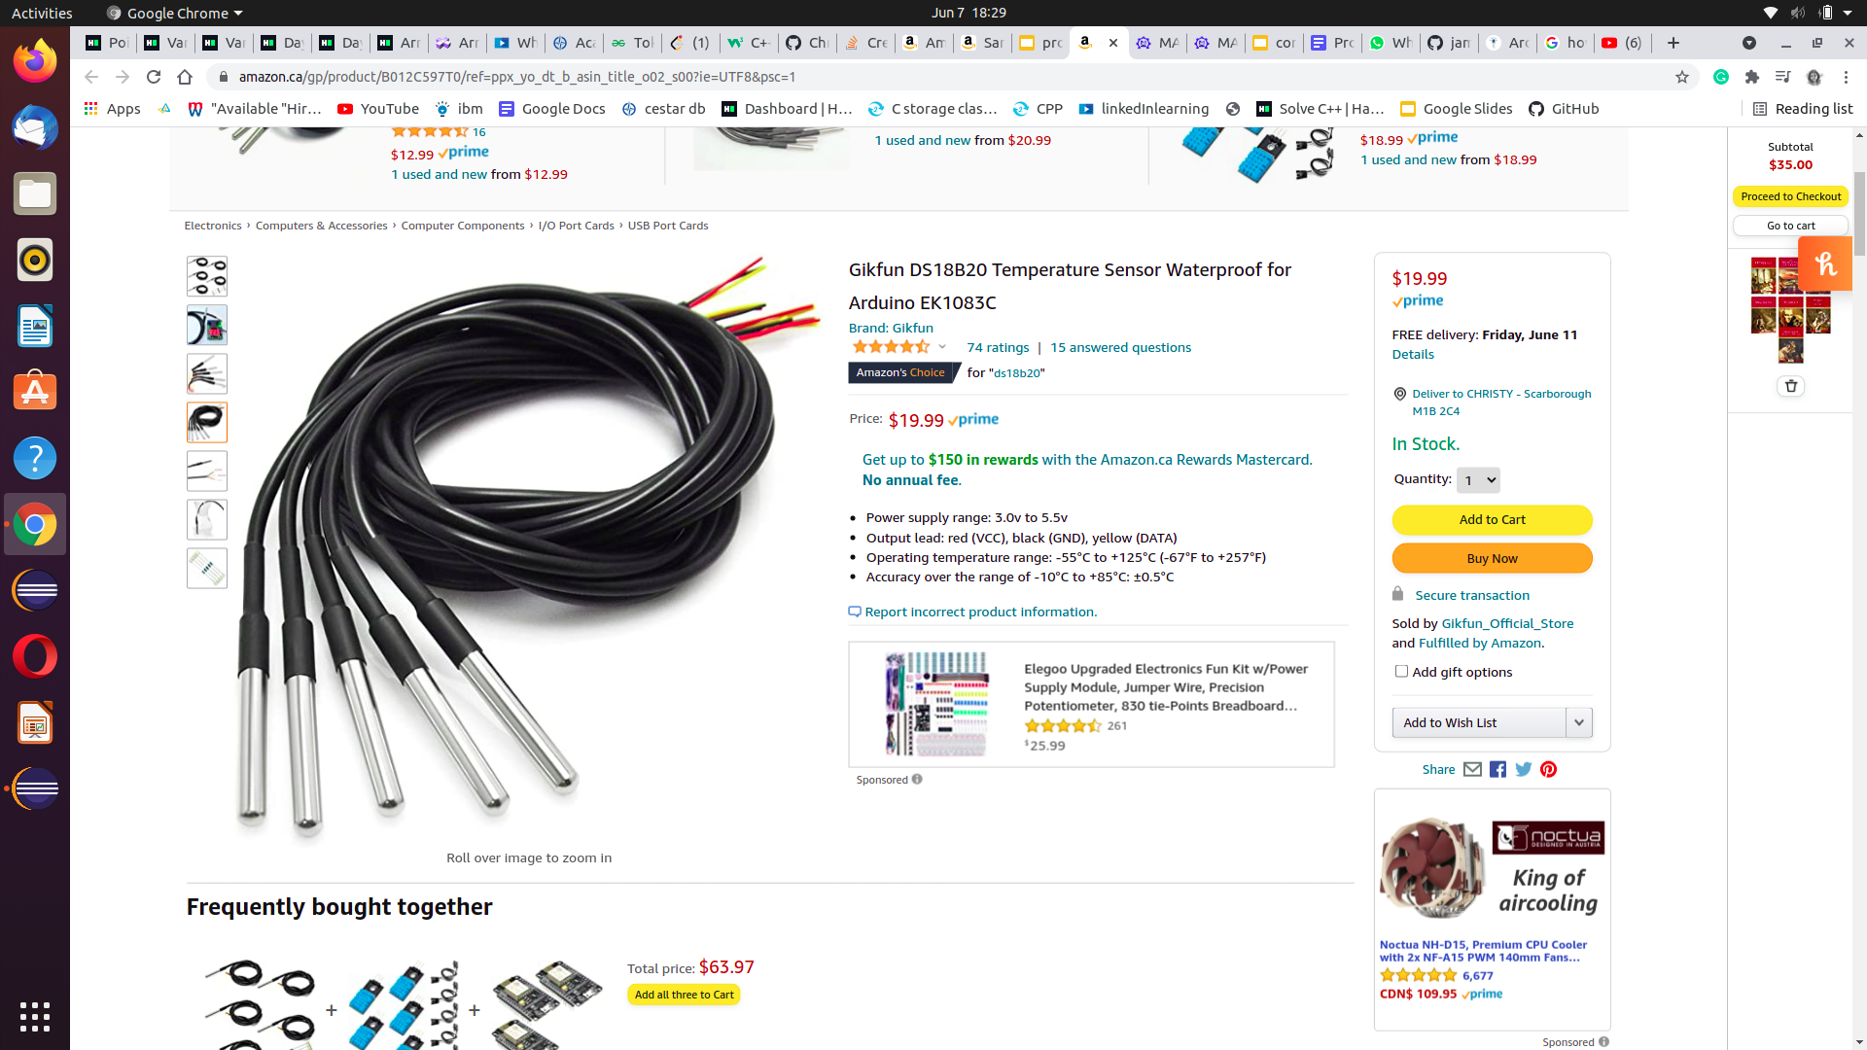
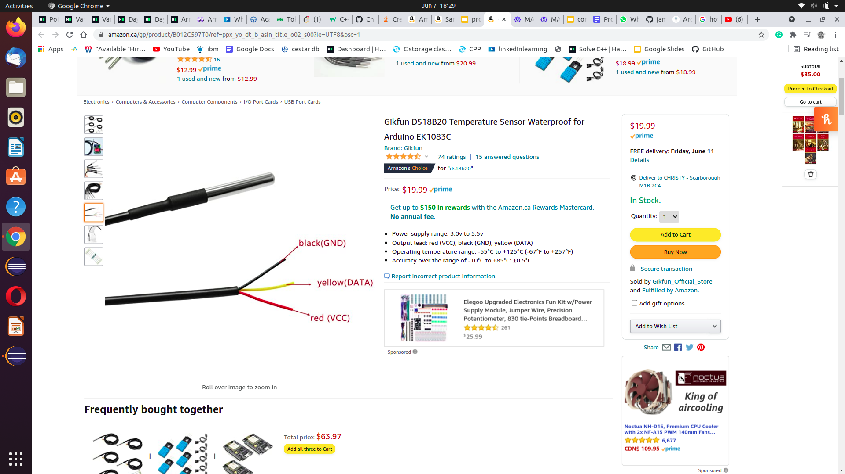
One Wire Digital Temperature Sensor - DS18B20.
￼￼DS18B20 is 1-Wire interface Temperature sensor manufactured by Dallas Semiconductor Corp. The unique 1-Wire Interface requires only one digital pin for two way communication with a microcontroller.

Slide 19
One Wire Digital Temperature Sensor - DS18B20.
DS18B20 temperature sensor is fairly precise and needs no external components to work. It can measure temperatures from -55°C to +125°C with ±0.5°C Accuracy.
The resolution of the temperature sensor is user-configurable to 9, 10, 11, or 12 bits. However, the default resolution at power-up is 12-bit (i.e. 0.0625°C precision).
Specifications:
Power Supply 3V to 5.5V
Current Consumption 1mA
Temperature Range -55 to 125°C
Accuracy ±0.5°C

Slide 20
Testing Process
Here we are testing One Wire Digital Temperature Sensor - DS18B20 with the help of an Arduino UNO Board.
Connections
Connect the Vin pin of DS18B20 to Vin pin of Arduino.
Connect the GND pin of DS18B20 to GND pin of Arduino.
Then connect Red stripe to 5V, Black connects to ground and Yellow Stripe is data that goes to digital pin 2 on arduino.
Then add a 4.7k pull-up resistor between the signal and power pin to keep the data transfer stable.
When we do this connections and the Code is uploaded, open the serial monitor to see the values.
The circuit diagram and coding is adding in the following slides.

Slide 21
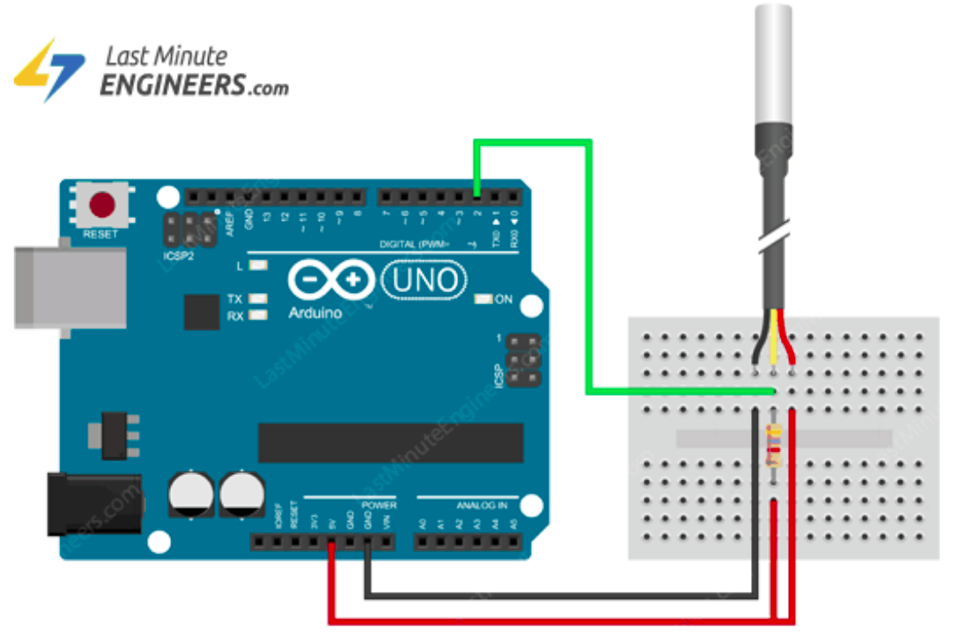
Circuit Diagram

Slide 22
Source Code
#include <OneWire.h>
#include <DallasTemperature.h>
// Data wire is plugged into digital pin 2 on the Arduino
#define ONE_WIRE_BUS 2
// Setup a oneWire instance to communicate with any OneWire device
OneWire oneWire(ONE_WIRE_BUS);
// Pass oneWire reference to DallasTemperature library
DallasTemperature sensors(&oneWire);
void setup(void)
{
sensors.begin(); // Start up the library
Serial.begin(9600);
}
void loop(void)
{
// Send the command to get temperatures
sensors.requestTemperatures();
//print the temperature in Celsius
Serial.print("Temperature: ");
Serial.print(sensors.getTempCByIndex(0));
Serial.print((char)176);//shows degrees character
Serial.print("C | ");
//print the temperature in Fahrenheit
Serial.print((sensors.getTempCByIndex(0) * 9.0) / 5.0 + 32.0);
Serial.print((char)176);//shows degrees character
Serial.println("F");
delay(500);
}

Slide 23
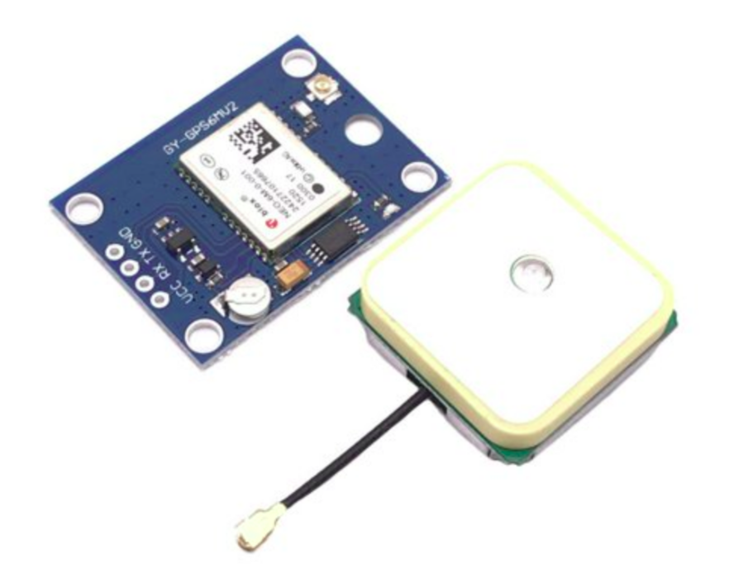
GPS Module.
￼
￼
￼
This module is a NEO-6M GPS chip from u-blox. It can track up to 22 satellites on 50 channels and achieves the industry’s highest level of sensitivity i.e. -161 dB tracking, while consuming only 45mA supply current.
Unlike other GPS modules, it can do up to 5 location updates a second with 2.5m Horizontal position accuracy. The u-blox 6 positioning engine also boasts a Time-To-First-Fix (TTFF) of under 1 second.
One of the best features the chip provides is Power Save Mode(PSM). It allows a reduction in system power consumption by selectively switching parts of the receiver ON and OFF. This dramatically reduces power consumption of the module to just 11mA making it suitable for power sensitive applications like GPS wristwatch.

Slide 24
Testing Process
Here we are testing the GPS MOdule with the help of an Arduino UNO Board.
Connections
Connect the GPS Power pin to 5V
Connect the GPS Ground pin to ground
Connect the GPS TX (transmit) pin to Digital 8
Connect the GPS RX (receive) pin to Digital 7
The board can work with the voltage input between 3.3V to 5V.
When we do this connections and the Code is uploaded, open the serial monitor to see the values.
The circuit diagram and coding is adding in the following slides.

Slide 25
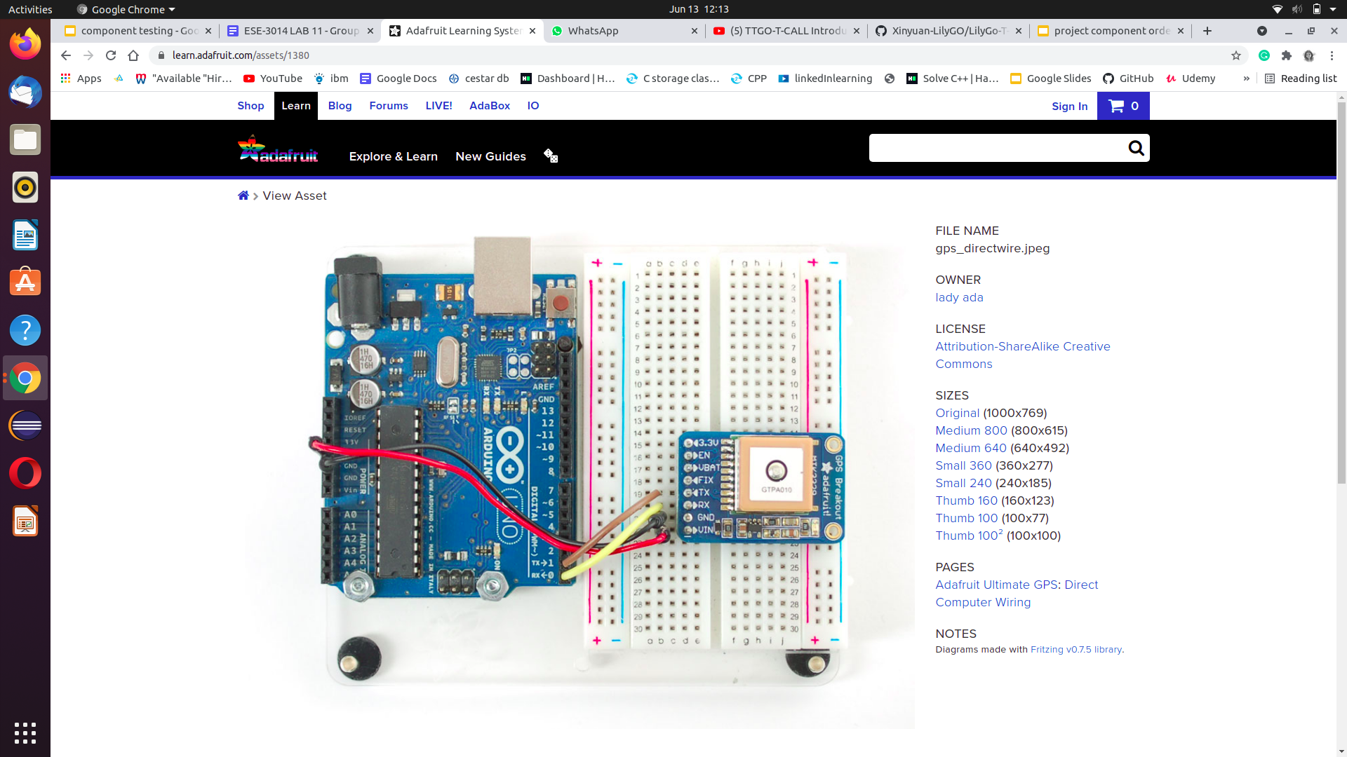
Circuit Diagram
￼

Slide 26
Source Code
// uncomment this line to turn on RMC (recommended minimum) and GGA (fix data) including altitude GPS.sendCommand(PMTK_SET_NMEA_OUTPUT_RMCGGA);
// uncomment this line to turn on only the "minimum recommended" data for high update rates! //GPS.sendCommand(PMTK_SET_NMEA_OUTPUT_RMCONLY);
// uncomment this line to turn on all the available data - for 9600 baud you'll want 1 Hz rate //GPS.sendCommand(PMTK_SET_NMEA_OUTPUT_ALLDATA);
// Set the update rate
// 1 Hz update rate //GPS.sendCommand(PMTK_SET_NMEA_UPDATE_1HZ);
// 5 Hz update rate- for 9600 baud you'll have to set the output to RMC or RMCGGA only (see above) GPS.sendCommand(PMTK_SET_NMEA_UPDATE_5HZ);
// 10 Hz update rate - for 9600 baud you'll have to set the output to RMC only (see above) //GPS.sendCommand(PMTK_SET_NMEA_UPDATE_10HZ);

Slide 27
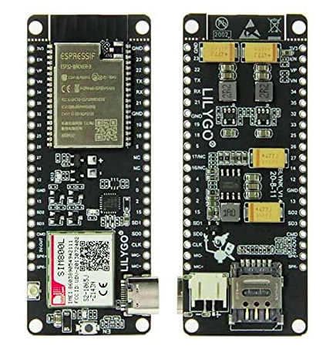
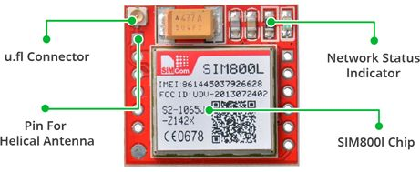
GSM Module [ESP32 Wireless Module GPRS Antenna SIM Card SIM800L Board]
￼
￼
￼

Slide 28
GSM Module [ESP32 Wireless Module GPRS Antenna SIM Card SIM800L Board]
The heart of the module is a SIM800L GSM cellular chip from SimCom. The operating voltage of the chip is from 3.4V to 4.4V, which makes it an ideal candidate for direct LiPo battery supply. This makes it a good choice for embedding into projects without a lot of space. All the necessary data pins of SIM800L GSM chip are broken out to a 0.1″ pitch headers. This includes pins required for communication with a microcontroller over UART. The module supports baud rate from 1200 bps to 115200 bps with Auto-Baud detection.

Slide 29
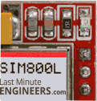
Testing Process
To test the GSM Module in ESP32, first we need an activated sim. One we put the sim to the slot, we can check it by a call or text message. Once it receive a text or message to that number, the LED will blinks.
Netlight LED Blinking Network Connection Established
The module has made contact with the cellular network & can send/receive voice and SMS.
Required codes available here: https://github.com/Xinyuan-LilyGO/LilyGo-T-Call-SIM800

Slide 30

Push Button.
Push-Buttons are normally-open tactile switches. Push buttons allow us to power the circuit or make any particular connection only when we press the button. Simply, it makes the circuit connected when pressed and breaks when released. These are the most common buttons which we see in our daily life electronic equipment.

Slide 31
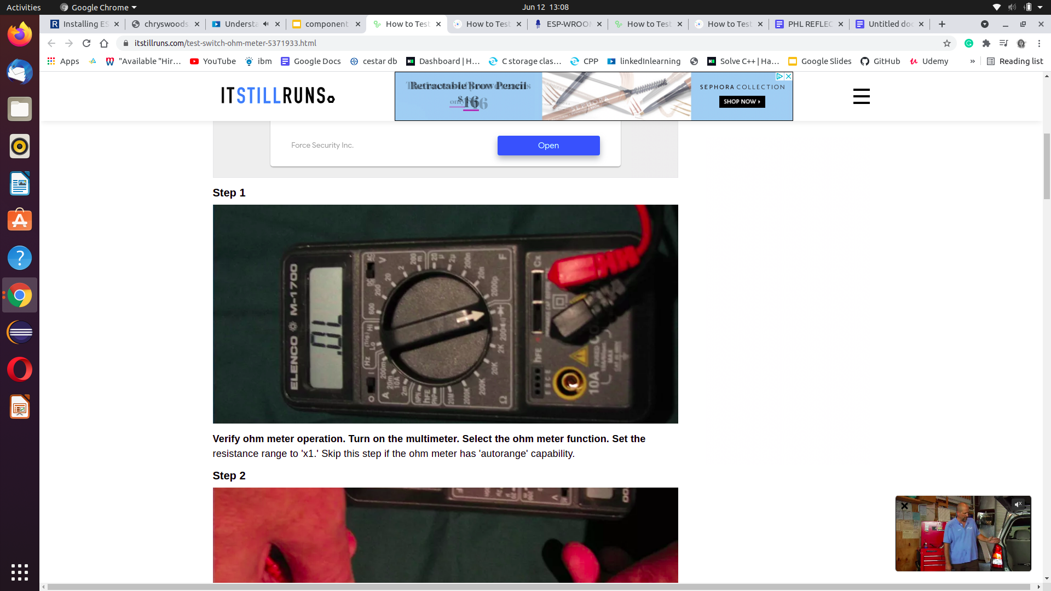
Testing Process
We are testing the push using a multimeter. The steps are explaining below,
Step 1
Verify ohm meter operation. Turn on the multimeter. Select the ohm meter function. Set the resistance range to 'x1.' Skip this step if the ohm meter has 'autorange' capability.

Slide 32
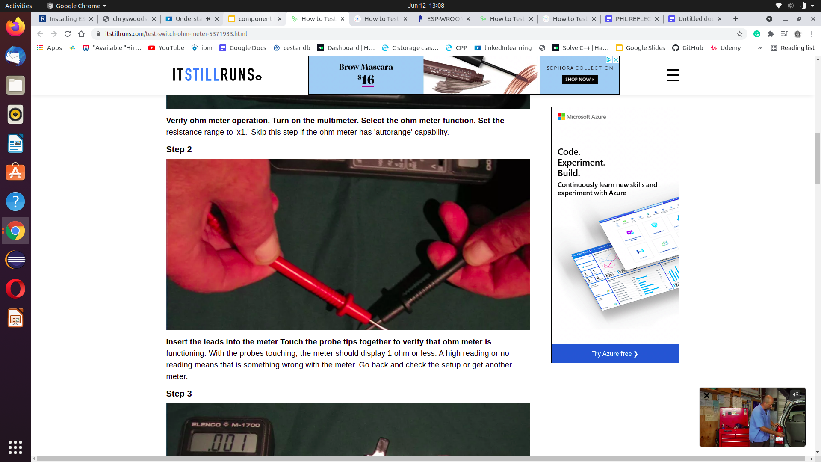
Testing Process
Step 2
Insert the leads into the meter Touch the probe tips together to verify that ohmmeter is functioning. With the probes touching, the meter should display 1 ohm or less. A high reading or no reading means that is something wrong with the meter. Go back and check the setup or get another meter.

Slide 33
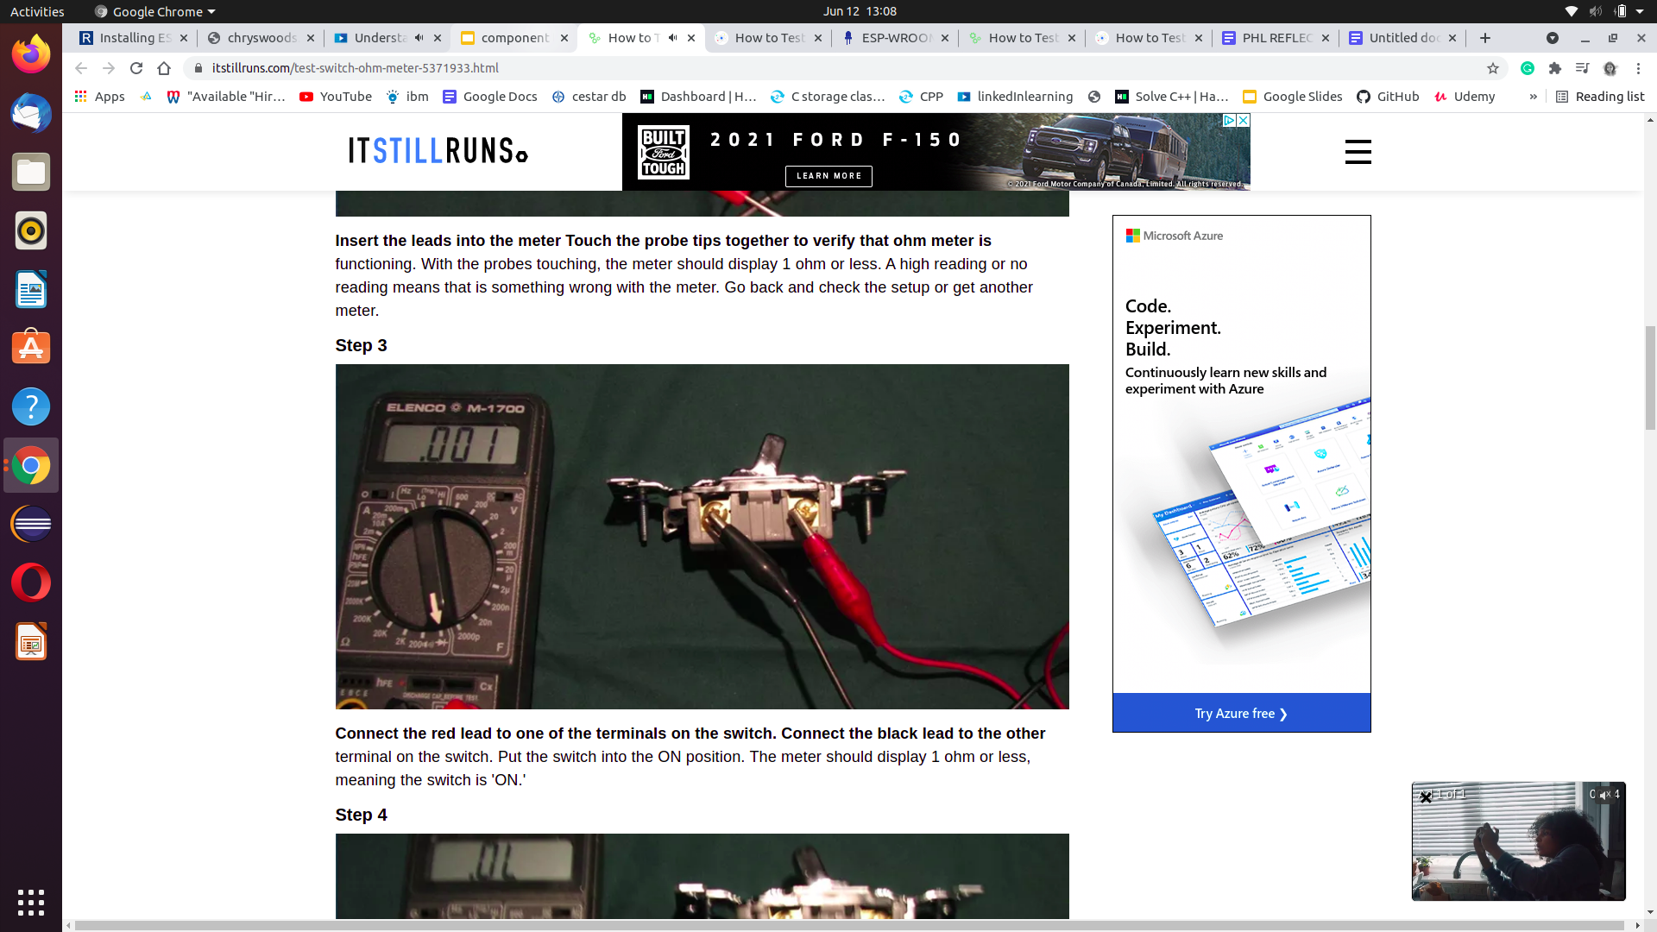
Testing Process
Step 3
Connect the red lead to one of the terminals on the switch. Connect the black lead to the other terminal on the switch. Put the switch into the ON position. The meter should display 1 ohm or less, meaning the switch is 'ON.'

Slide 34
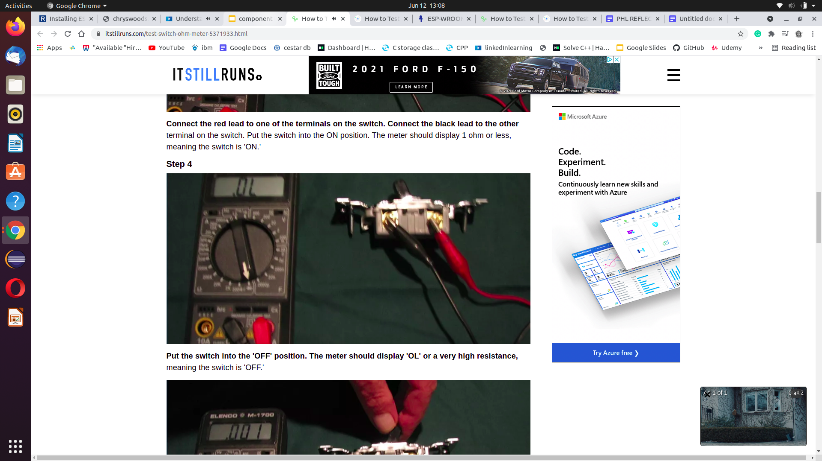
Testing Process
Step 4
Put the switch into the 'OFF' position. The meter should display 'OL' or a very high resistance, meaning the switch is 'OFF.'

Slide 35
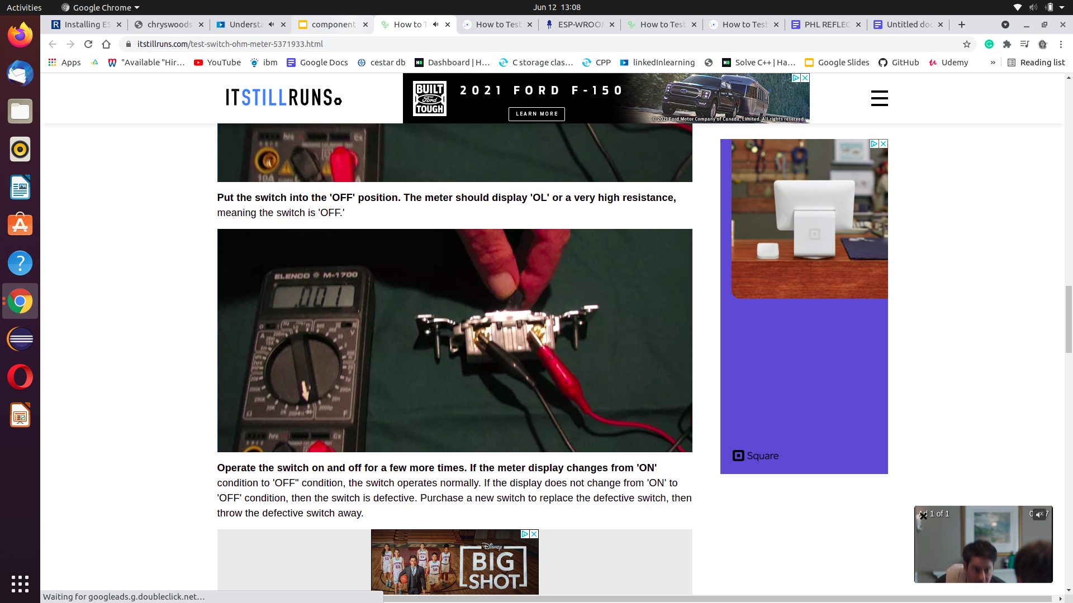
Testing Process
￼
￼
￼
￼
￼
Operate the switch on and off for a few more times. If the meter display changes from 'ON' condition to 'OFF" condition, the switch operates normally. If the display does not change from 'ON' to 'OFF' condition, then the switch is defective. Purchase a new switch to replace the defective switch, then throw the defective switch away.

Slide 36
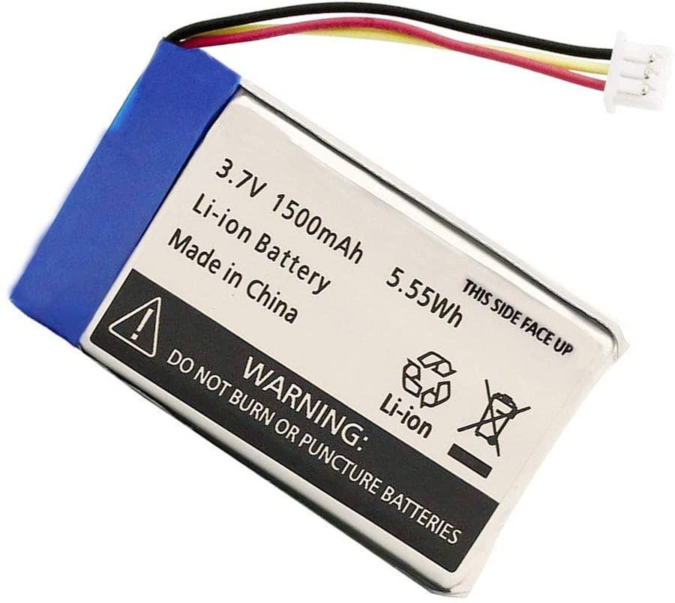
Lithium Ion Battery
These are the latest in rechargeable battery technology, and are quickly becoming the most common batteries for consumer electronics like camcorders, cell phones, laptops etc.

Slide 37
Lithium Ion Battery
They are very lightweight, don't mind high discharge rates, and have very high power density. However, they are very delicate and require special circuitry to keep them from exploding! This means that raw LiIon cells are very rare and very dangerous. Most li-ion batteries come with protection circuitry that keeps the battery operating safely. Li-Ion cells are around 3.6V so 3.6V and 7.2V are the most common battery voltages you'll see. They can easily provide up to 1C of current, some can go up to 10C!
Pros: Ultra-light, high power, high capability, high cell voltage.
Cons: One drawback with rechargeable lithium batteries is their life expectancy of about two to three years. Over time, lithium ion batteries lose their capacity to hold a charge.

Slide 38
Testing Process
Step 1: Turn on the power to your volt meter.
Step 2: Set your meter to measure in volts.
Step 3: Locate the positive and negative terminals of your lithium ion battery. These will usually be located on the end of your battery that slides first into the device it powers. The terminals are tiny, but they are clearly marked with a positive and negative symbol.
Step 4: Place the corresponding positive and negative leads of your voltmeter into the terminals of your battery. The amount of charge (or volts) will be displayed on the multimeter.

Slide 39
Conclusion
In conclusion, in this presented we discussed the testing methods of the major components such as, ESP32 Board, MAX30102 Pulse Oximeter & Heart-Rate Module, One Wire Digital Temperature Sensor - DS18B20, GPS Module, GSM Module, Push Button, and Lithium-ion Battery with the help of Arduino UNO Board and Multimeter.

Slide 40
References.
Starting Electronics. (2017, September 21). ESP-WROOM-32 Testing and First Use of ESP32. https://startingelectronics.org/articles/ESP32-WROOM-testing/#:~:text=The%20first%20and%20most%20basic,on%2Dboard%20regulator%20is%20working
N. Alex. (2020, May 10). Interfacing MAX30100 Pulse Oximeter Sensor with Arduino, How2Electronics. https://how2electronics.com/interfacing-max30100-pulse-oximeter-sensor-arduino/
Last minute Engineers. (n.d.). Sim800 L. Sim800L. https://lastminuteengineers.com/sim800l-gsm-module-arduino-tutorial/
Random Nerd Tutorials. (n.d.).Introducing the TTGO T-Call ESP32 SIM800L. https://randomnerdtutorials.com/esp32-sim800l-publish-data-to-cloud/
Push Button Switch. (2018, March 6). Components 101. https://components101.com/switches/push-button
K. Lynch, M. (n.d.). How to Test a Switch With an Ohm Meter. It Still Runs. https://itstillruns.com/test-switch-ohm-meter-5371933.html

Slide 41
References.
Adafruit. (n.d.). Li-Ion (Lithium-Ion) and LiPoly (Lithium Polymer). Adafruit. https://learn.adafruit.com/all-about-batteries/liion-lithium-ion-and-li-poly-lithium-polymer
D. Ashton. (2017, April 24). By How to Test Lithium Ion Batteries. https://sciencing.com/test-lithium-ion-batteries-6886166.html
Adafruit. (n.d.). Adafruit Ultimate GPS. https://learn.adafruit.com/adafruit-ultimate-gps?view=all#built-in-logging
Interfacing DS18B20 1-Wire Digital Temperature Sensor with Arduino, (n.d.). Last Minute Engineers. https://lastminuteengineers.com/ds18b20-arduino-tutorial/
Send Receive SMS & Call with SIM800L GSM Module & Arduino, (n.d.). Last Minute Engineers. https://lastminuteengineers.com/sim800l-gsm-module-arduino-tutorial/
ESP32 Publish Data to Cloud without Wi-Fi (TTGO T-Call ESP32 SIM800L) , (n.d.). Random Nerd Tutorials. https://randomnerdtutorials.com/esp32-sim800l-publish-data-to-cloud/
Github. (2021, March 28). LilyGo T-Call SIM800 Series. https://github.com/Xinyuan-LilyGO/LilyGo-T-Call-SIM800

Slide 42
Thank you

